Slide 1
”DIKSHA” Sundaram Fin.Tech 2025
Journey Presentation –week 11
Anil Rasa
Date : 27-Apr-2025

Slide 2

Topics Covered in Eleventh Week !

Slide 3
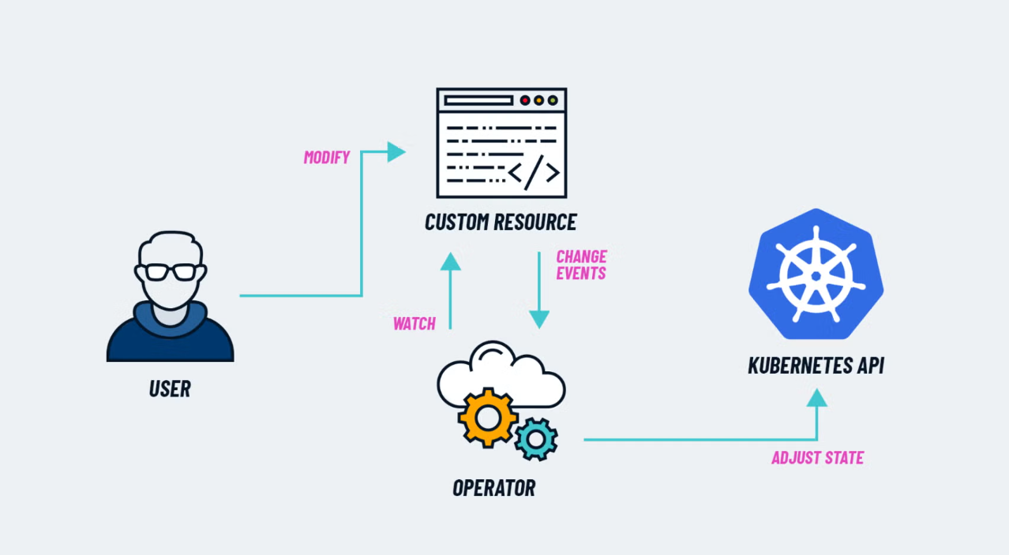
Learning 1 | My takeaways
→K8s Components
→K8s Architecture
→ELK
→Kubernets

Slide 4
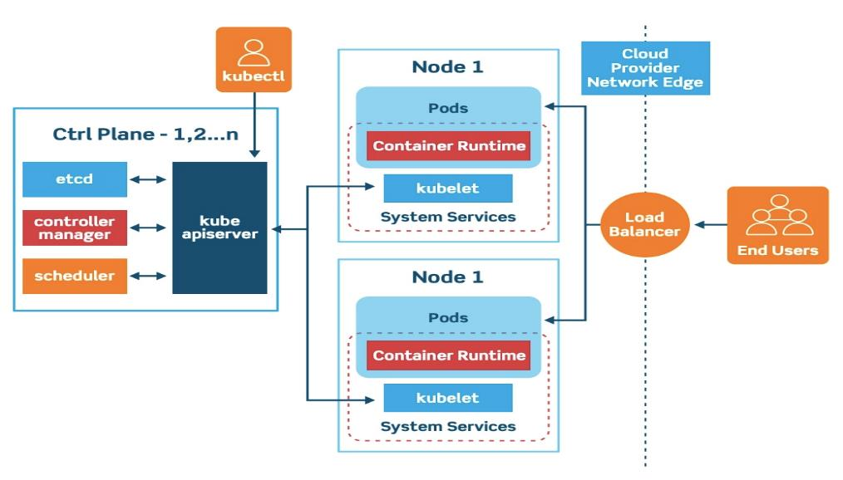
Kubernets:
Kubernetes (often abbreviated as K8s) is an open-source platform for automating the deployment, scaling, and management of containerized applications.
K8s Components:
1)Pod:- The smallest unit. It wraps one or more containers together.
2) Node :- A worker machine (virtual or physical) where Pods run.
3) Cluster:- A collection of Nodes managed by Kubernetes.
4) Deployment:- Tells Kubernetes how to create/update Pods automatically.
5) Service:- Exposes a group of Pods to the network (inside or outside the cluster).
K8s Architecture:
A Kubernetes cluster consists of a control plane plus
a set of worker machines, called nodes, that run
containerized applications
ELK:
Elasticsearch:
A search and analytics engine (stores and searches logs)
Logstash:
A data processing pipeline (collects, processes, and sends data)
Kibana:
A dashboard tool (visualizes the data)
Q

Slide 5
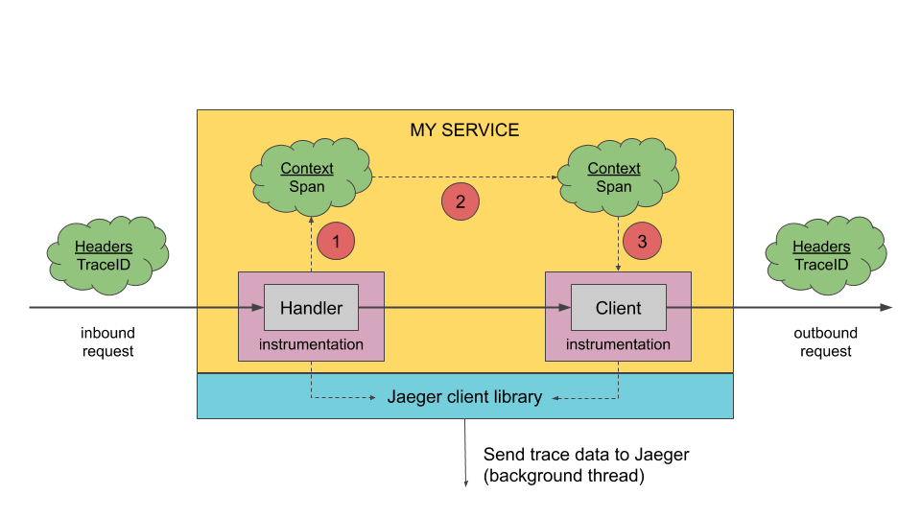
Learning 2| My Takeaways
→ EFK
→ Jaeger
→ Jaeger Architecture
→ SonarQube

Slide 6
EFK:
Elasticsearch:
A search and analytics engine (stores and searches logs)
Fluentd:
grabs those logs and ships them.
Kibana:
A dashboard tool (visualizes the data)
Jaeger:
Jaeger is an open-source distributed tracing system. It helps you trace how requests move through different services in a microservices architecture.
Jaeger Architecture:
→Jaeger Client
→Jaeger Agent
→Jaeger Collector
→Storage
→Jaeger UI
SonarQube:
SonarQube is an open-source platform used to continuously inspect the quality of your code.
SonarQube Scanner analyzes the source code.
Database stores historical data, analysis reports, and settings.

Slide 7
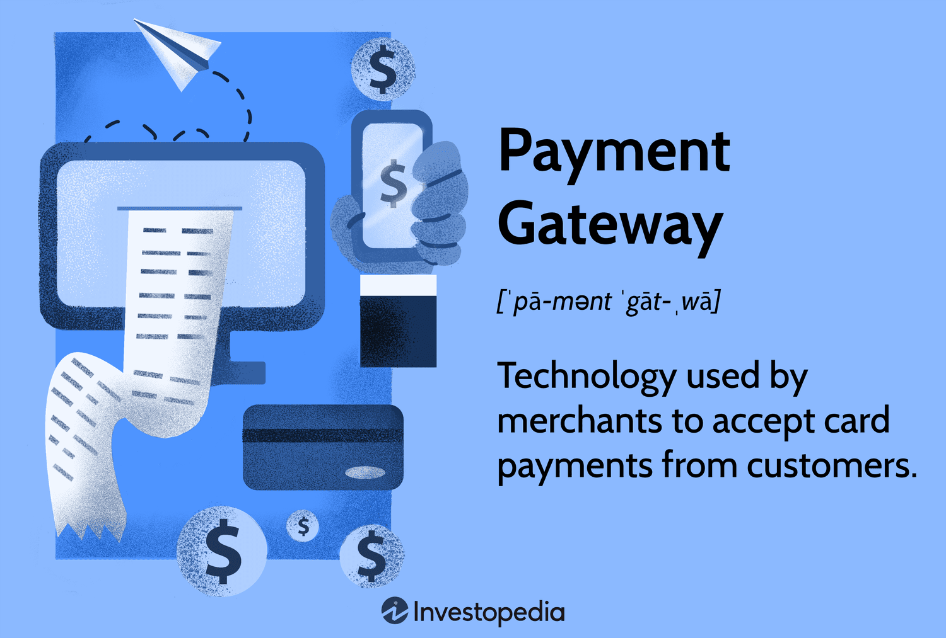
Learning 3| My takeaways
→Paytech and Payment Gateway
→Paytech Introduction
→Key Innovation in Paytech
→Lifecycle of Digital Payment

Slide 8
Paytech and Payment Gateway
Paytech introduction:
Paytech = Payment Technology.
It refers to technological innovations that enable or improve how payments are made — both online and offline.
Key Innovation in Paytech:
Contactless Payments:- Tap-and-go cards, mobile wallets (NFC payments)
Digital Wallets:- Apps like Paytm, Apple Pay, Google Pay storing your cards securely
Buy Now, Pay Later (BNPL):-Pay for products later (e.g., Klarna, Afterpay)
Crypto Payments:- Using Bitcoin, Ethereum for transactions
Biometric Payments:- Payments using fingerprint, face recognition
Lifecycle of Digital Payment:
Initiation:User starts the payment (card swipe, scan QR, click "Pay")
Authorization:Payment gateway (like Razorpay, Stripe) checks if payment can happen
Authentication:User confirms identity (OTP, biometrics, PIN)
Processing:Bank/payment processor moves the money
Settlement:Money is transferred to the merchant’s bank account
Confirmation:User and merchant both get payment success message
Reconciliation:Behind the scenes: matching transactions in bank records

Slide 9

Learning 4 | takeaways
→ Android studio
Layout
→Activity
→ OnClicklistner

Slide 10
Android Studio:
In Android Studio, a layout defines how the UI elements (like buttons, text fields, images) are arranged on the screen. Usually, you define layouts using XML files inside the layout folder.
Layout:
In Android Studio, you can edit layouts in two ways:
Design View (drag and drop UI components)
Code View (edit the XML directly)
Activity:
An Activity is a screen in an Android app. Every time you open a new screen (like login, profile, settings), you’re actually opening a new Activity.
Onclicklistner:
An OnClickListener is an interface in Android used to listen for click events.
It detects when a user taps (or clicks) on a view like a Button, ImageView, TextView, CardView, etc.
When the user clicks, some code inside the onclick() method is automatically executed.

Slide 11
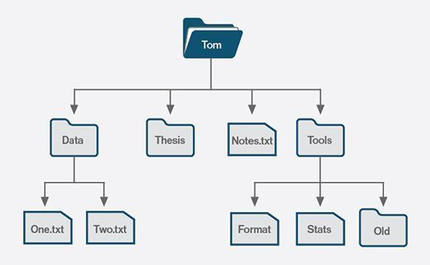
Learning 5 | takeaways
→Shared Preferences
→Files system
→API
→Fetching API

Slide 12
Shared Preferences:
→Key-value pair storage.
→Lightweight and simple.
→Best for storing user settings, login states, small pieces of information.
File System:
→Used for storing larger or structured data.
→Two main types:
Internal Storage (private to app)
External Storage (shared across apps)
API:
→Enables communication between app and server.
→Types of APIs
REST APIs: Most common; uses HTTP methods.
SOAP APIs: XML-based communication.
GraphQL: Flexible queries.
Fetching API:
→Making network requests from the app.
→Fetching data from remote servers.
→Updating information on the server.

Slide 13
Thank You

